Slide 1

COIS 3320: Fundamentals of Operating Systems
Alaadin Addas
Week 4
More Scheduling ☹, Concurrency, C Programming

Slide 2
Overview
Announcements/Reminders
Recap
Scheduling
Scheduling of Interactive Processes
Scheduling of Real Time Processes
Combined Approaches
Concurrency
Process Interactions
Semaphores
C Programming
Functions
Strings in C

Slide 3
Announcements/Reminders
Your first assignment is due by the 7th of February 11:59PM
Your first lab is due by the 5th of February 11:59PM
Both your lab and assignment are subject to a 10% late penalty per business day if they are not submitted. Please make sure you submit them on time!

Slide 4
Recap (1)
What is the difference between long-term scheduling and short-term scheduling?
Long-term scheduling decides when a process should enter the ready state and start competing for the CPU.
Short-term scheduling decides which of the ready processes should run next on the CPU.
We discussed two different types of schedulers pre-emptive schedulers and non-preemptive. What is the difference?
Non-Preemptive: A non-preemptive scheduling algorithm allows a running process to continue until the process terminates or blocks on a resource.
Preemptive: A preemptive scheduling algorithm may stop the currently running process and choose another process to run.

Slide 5
Recap (2)
When it comes to batch process scheduling which is the fastest?
SJF
FIFO
SRT

Slide 6
Recap (2)
When it comes to batch process scheduling which is the fastest?
SJF
FIFO
SRT

Slide 7
Scheduling (Refresher)
Last week, we ended the scheduling portion of the lecture while we were discussing scheduling interactive processes.
We discussed the following scheduling algorithms in that section:
RR (Round Robin)
ML (Multilevel)
MLF (Multilevel Feedback)
We did not delve deep into which one is better!

Slide 8
Response Time
Response Time (Performance Metric): The response time of a process is the elapsed time from the submission of a request. This is a performance metric.
For a process running alone, the response time depends on the type of request. E.g., The time between pressing a key and seeing the character appear on the screen should be imperceptible by the human eye. A request to spell-check a document or render a video clip could take a few seconds.
When multiple processes time-share the CPU, the response time increases with the number of processes, the length of the time quantum, and the time it takes to perform a context switch.

Slide 9
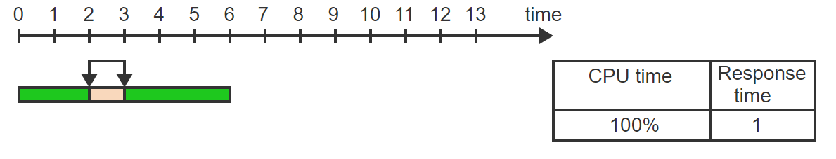
Time Sharing Performance – Visualized - 1
The response time of a process is the interval between making a request and receiving a response. The process uses 100% of the CPU and the response time (brown) is 1 unit

Slide 10
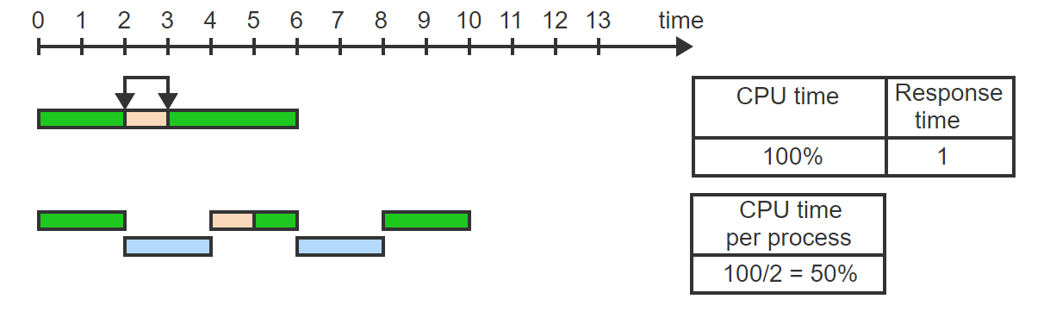
Time Sharing Performance – Visualized - 2
When 2 processes time-share the CPU and context switching overhead is negligible, the CPU is divided evenly between the two processes. Each process gets 50% of the CPU time.

Slide 11
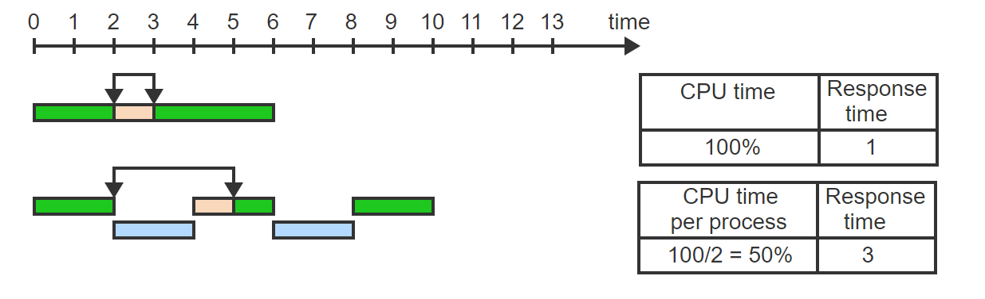
Time Sharing Performance – Visualized - 3
The first process experiences 2 additional units of response delay, which are used by the second process

Slide 12
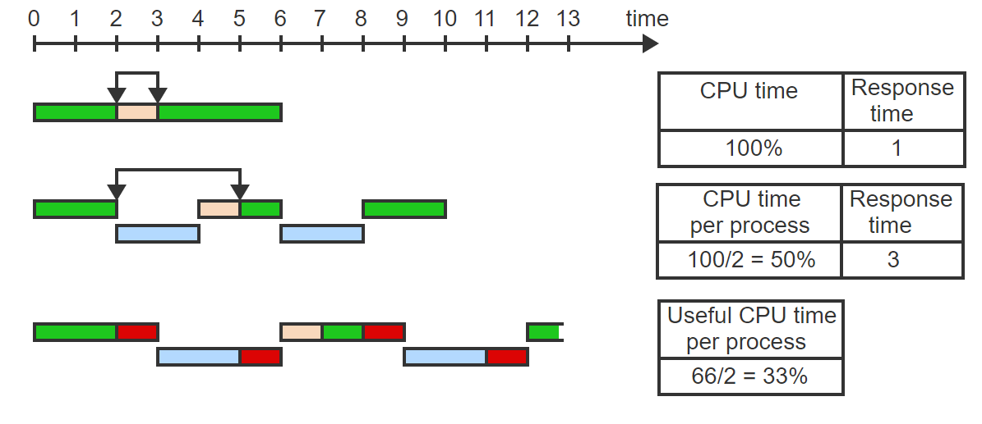
Time Sharing Performance – Visualized - 4
When the quantum is 2 units as before but context switching overhead is 1 (red), the useful CPU time is reduced to 66.66% and each process gets only 66.66/2 = 33.33% of the CPU time

Slide 13
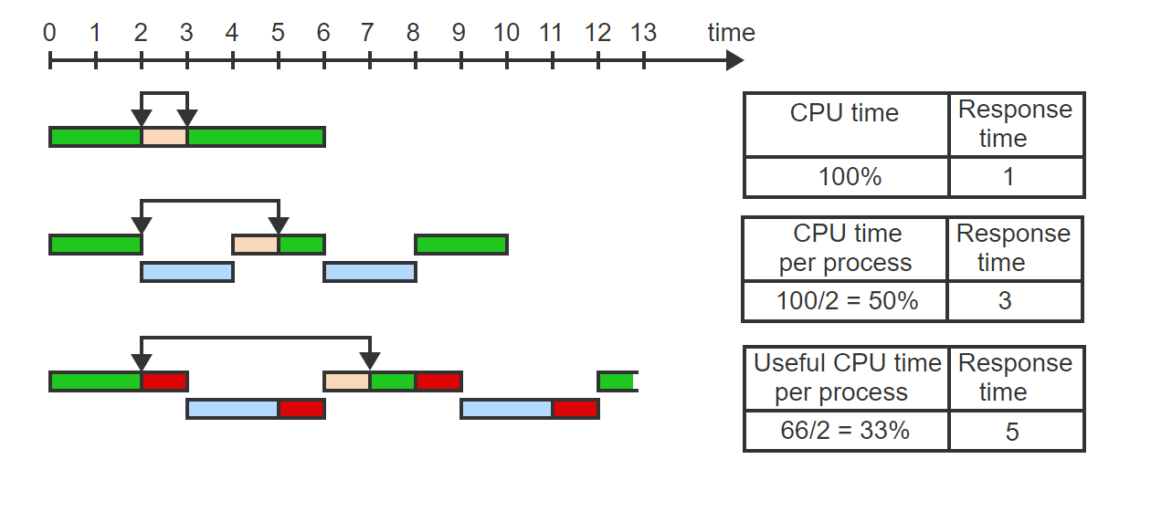
Time Sharing Performance – Visualized - 5
The response time increases to 5. One quantum (2 units) is used by the other process (blue) and 2 time units are used by the two context switches (red)

Slide 14
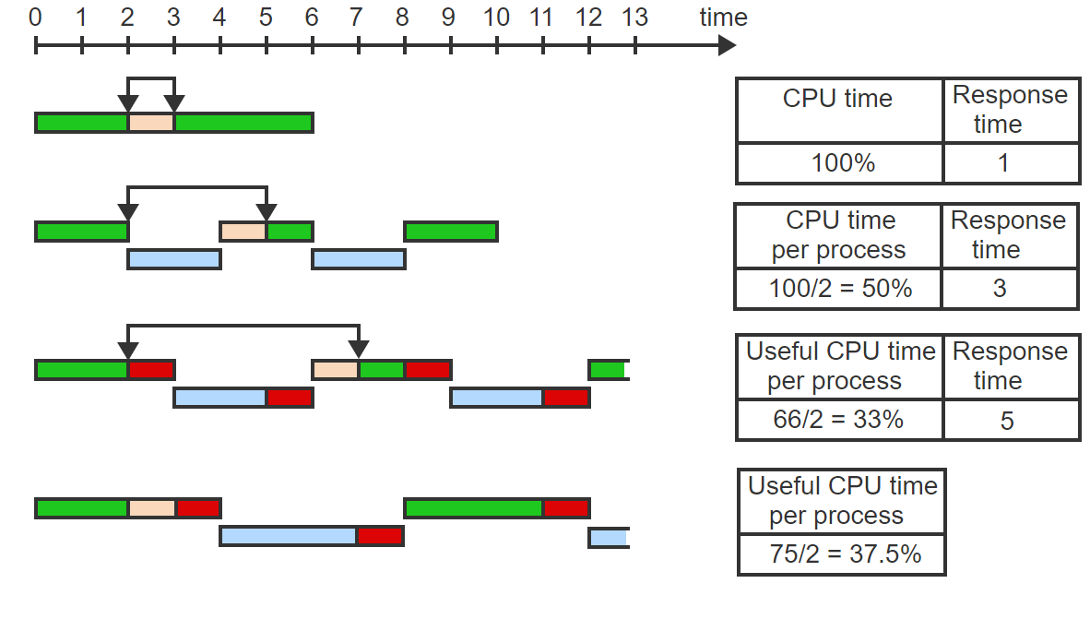
Time Sharing Performance – Visualized - 6
When the quantum is increased to 3 time units, the overhead (red) is reduced to 25%. Each process gets half of the useful CPU time: 75/2 = 37.5%

Slide 15
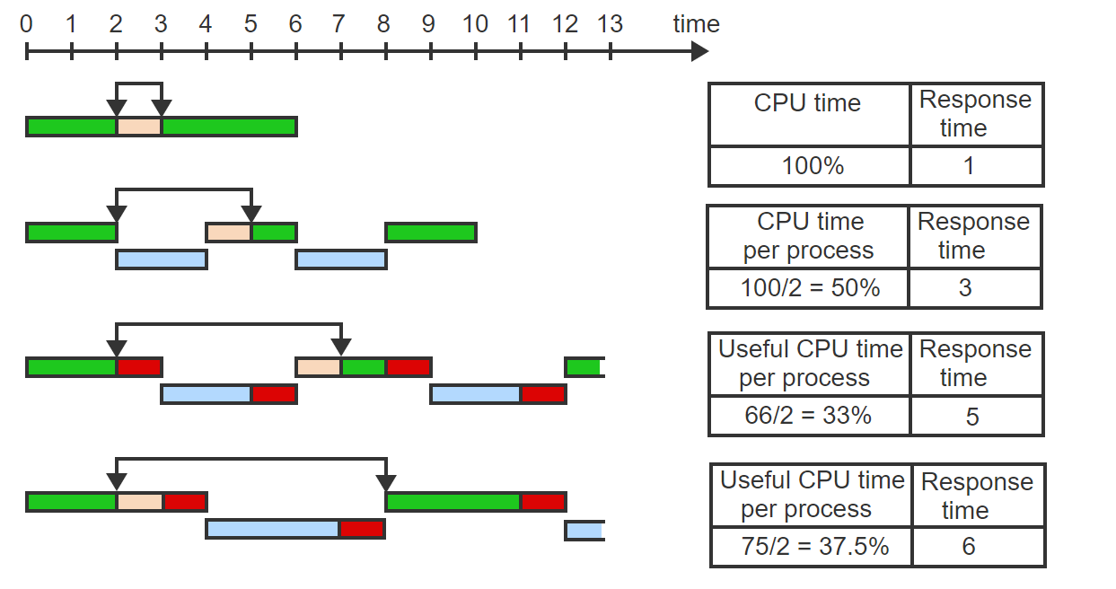
Time Sharing Performance – Visualized - 7
The price paid for the improved CPU utilization is an increase in the response time by 1 unit due to the longer quantum of the second process

Slide 16
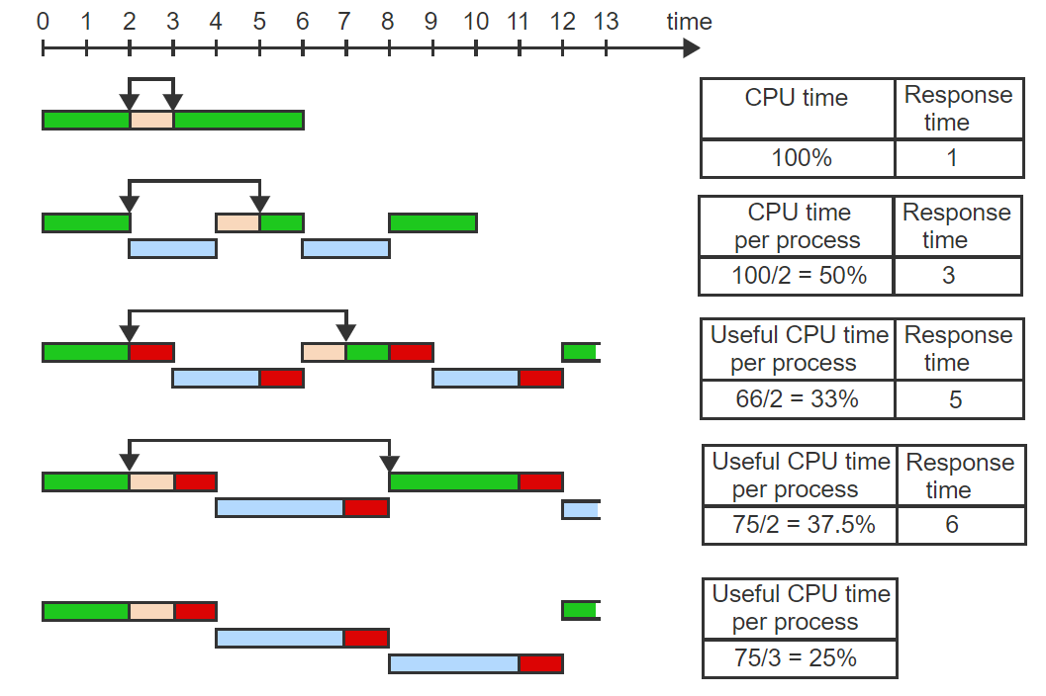
Time Sharing Performance – Visualized - 8
When a third process joins the group, the useful CPU is divided among the 3 processes: 75/3 = 25%

Slide 17
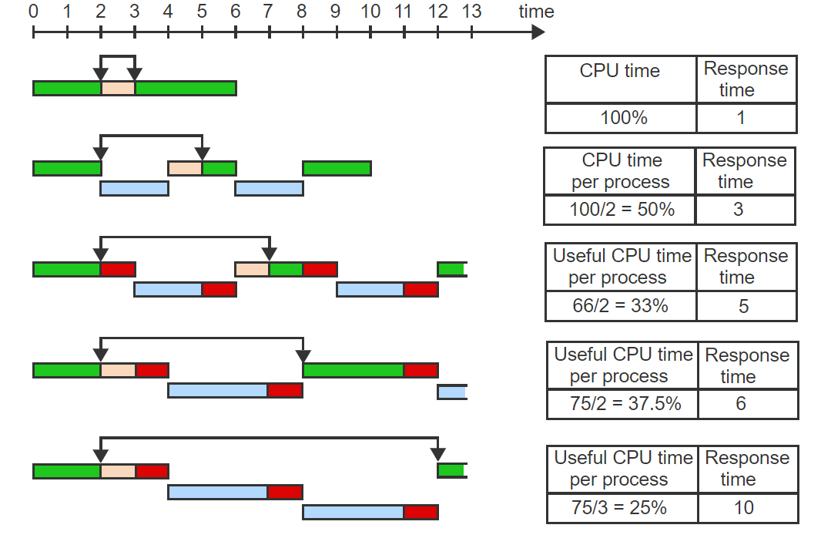
Time Sharing Performance – Visualized - 9
The response time increases correspondingly: 2 quanta (3 units each) for the other two processes (blue) plus 3 units for context switching overhead (red).

Slide 18
Verdict
So which is better?
It depends!

Slide 19
Exercise
5 processes are time-sharing the CPU using RR scheduling. The total CPU time of each process is 10 seconds (10,000 ms).
If context switching time is negligible, the total execution time of all processes will be _________ ms.
With a time quantum Q = 100 ms, each process will experience _________ time slices.
If the context switching time is S = 10 ms, the additional overhead from context switching is _________ % of Q.
If the context switching time is S = 10 ms, the total execution time of all processes will be _________ ms.

Slide 20
Exercise – Solution
5 processes are time-sharing the CPU using RR scheduling. The total CPU time of each process is 10 seconds (10,000 ms).
If context switching time is negligible, the total execution time of all processes will be 50,000 ms.
With a time quantum Q = 100 ms, each process will experience 100 time slices.
If the context switching time is S = 10 ms, the additional overhead from context switching is 10 % of Q.
If the context switching time is S = 10 ms, the total execution time of all processes will be 55,000 ms.

Slide 21
Real Time Process Scheduling
A real-time process is characterized by continual input, which must be processed fast enough to generate nearly instantaneous output.
A period is a time interval (typically in milliseconds or even microseconds) within which each input item must be processed.
A rate monotonic (RM) algorithm schedules processes according to the period. The shorter the period, the higher the priority.

Slide 22
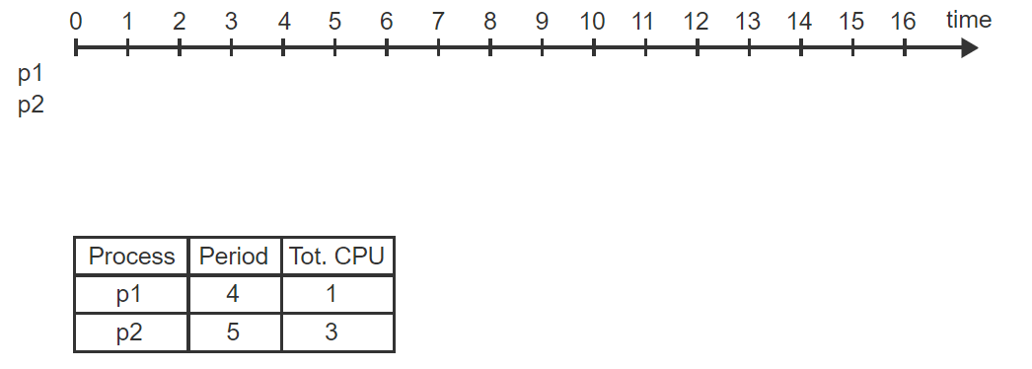
Visualizing A RM Algorithm – 1
Two periodic processes. p1 and p2, with the given periods and total CPU times, are scheduled using RM.

Slide 23
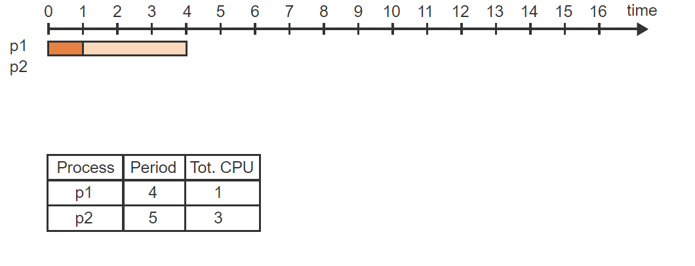
Visualizing A RM Algorithm – 2
p1 has a period of 4. The first computation of length 1 must be performed within times 0 and 4

Slide 24
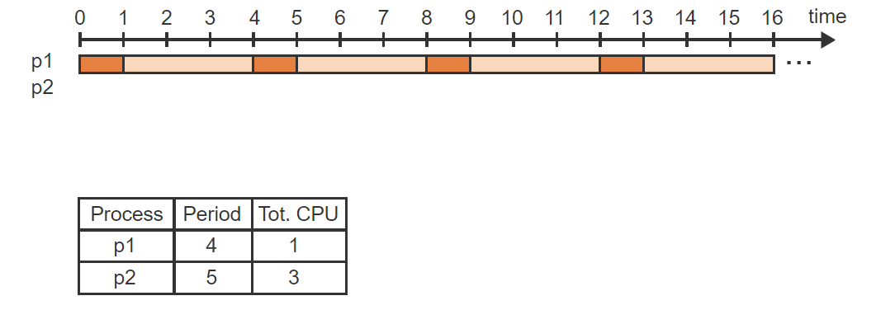
Visualizing A RM Algorithm – 3
The next computation must be performed within the times 4 and 8, and so on

Slide 25
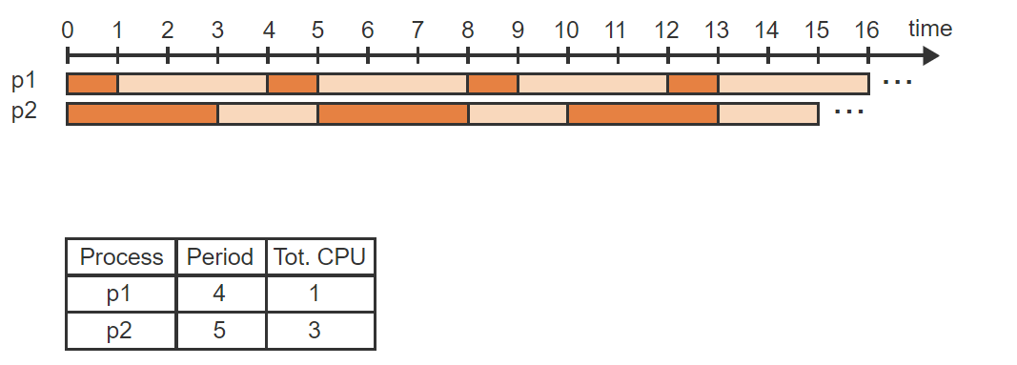
Visualizing A RM Algorithm – 4
p2 has a period of 5. The first computation of length 3 must be performed within times 0 and 5, and so on

Slide 26
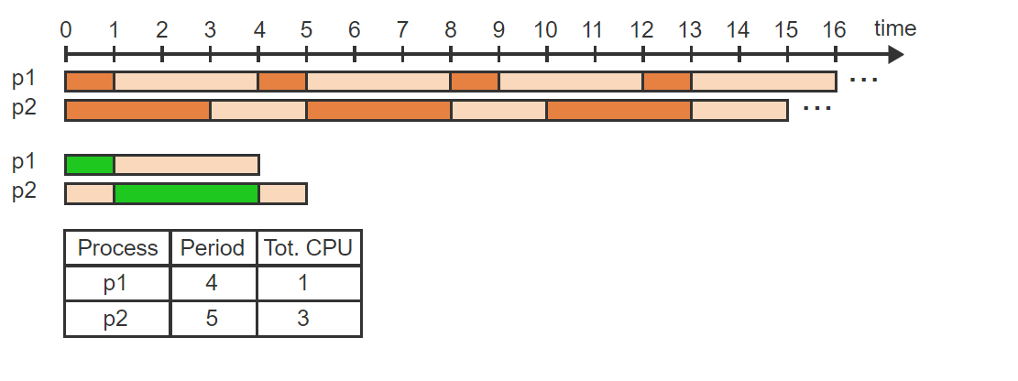
Visualizing A RM Algorithm – 5
Under RM, p1 has always the higher priority and starts executing at time 0, followed by p2 at time 1

Slide 27
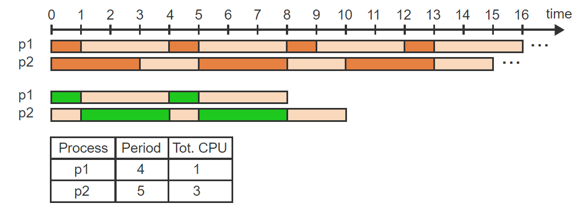
Visualizing A RM Algorithm – 6
At time 4, the next iteration of p1 is available and runs from 4 to 5. The next iteration of p2 is available at time 5 and runs from 5 to 8

Slide 28
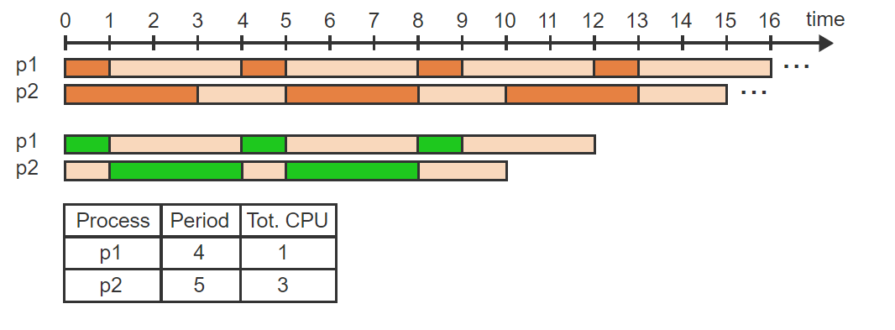
Visualizing A RM Algorithm – 7
At time 8, p1 is again available and executes

Slide 29
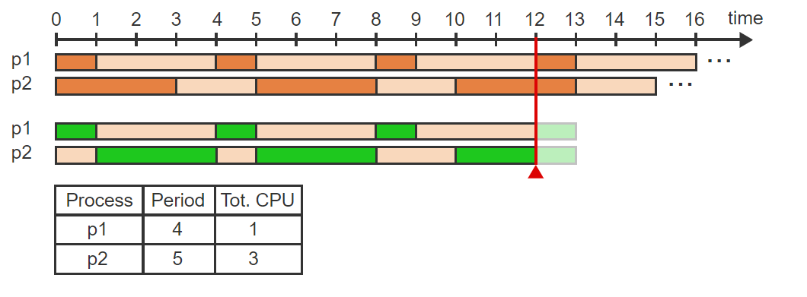
Visualizing A RM Algorithm – 8
p2 becomes available at time 10 and starts executing but does not complete because at time 12, p1 becomes available again

Slide 30
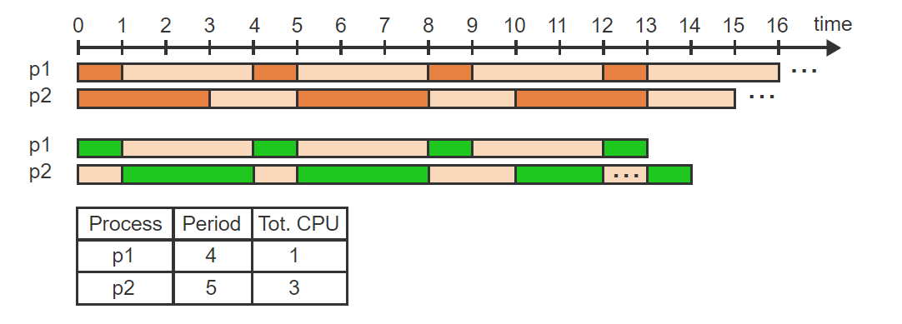
Visualizing A RM Algorithm – 9
p1 has higher priority and interrupts p2. The last time unit of p2 is postponed until time 13

Slide 31
Earliest Deadline First (EDF)
The earliest deadline first (EDF) algorithm schedules processes according to the shortest remaining time until the deadline. The shorter the remaining time, the higher the priority.
Earliest Deadline First (EDF) scheduling is an optimal preemptive scheduling algorithm for single core processors. What optimal means in this case is that all deadlines will be met, provided that the total CPU utilization is less than or equal to 100%.

Slide 32
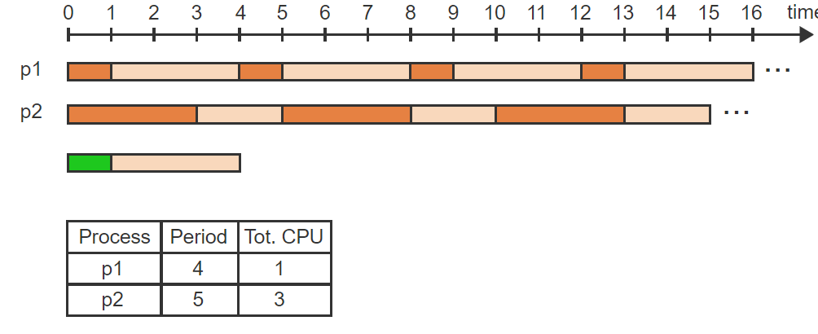
EDF Visualized – 1
Two periodic processes, p1 and p2, with the given periods and total CPU times, are scheduled using EDF

Slide 33
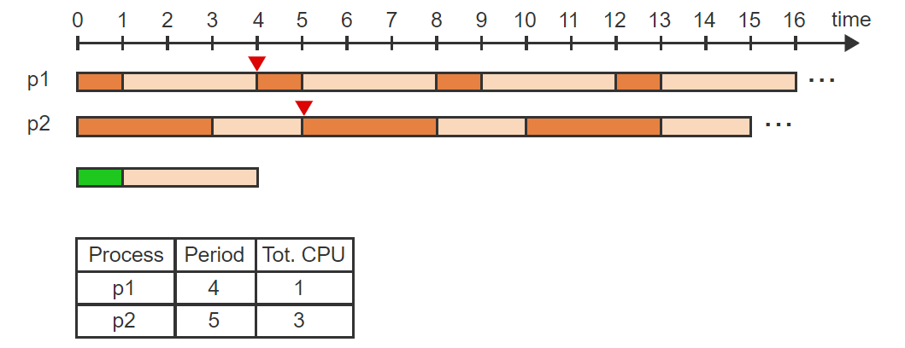
EDF Visualized – 2
The first computation of p1 has a deadline at 4 while the first computation of p2 has a deadline at 5

Slide 34
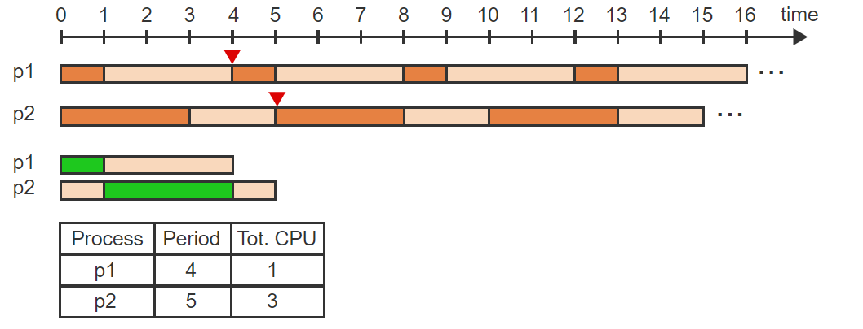
EDF Visualized – 3
p1 has a higher priority than p2 and starts executing at time 0, followed by p2 at time 1

Slide 35
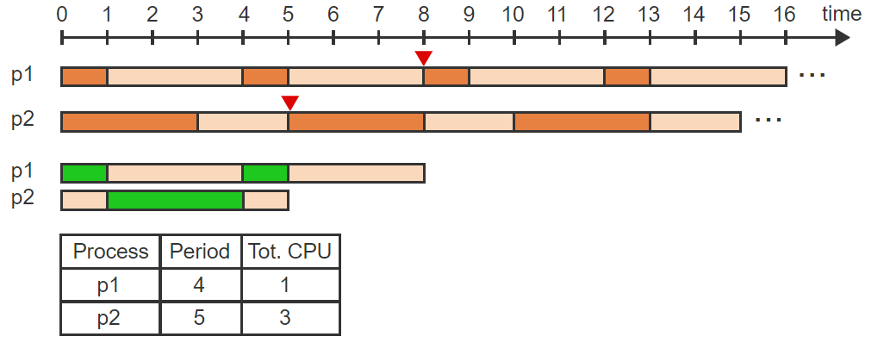
EDF Visualized – 4
At time 4, the deadline of p1 moves to 8. Only p1 is available and so p1 runs from 4 to 5.

Slide 36
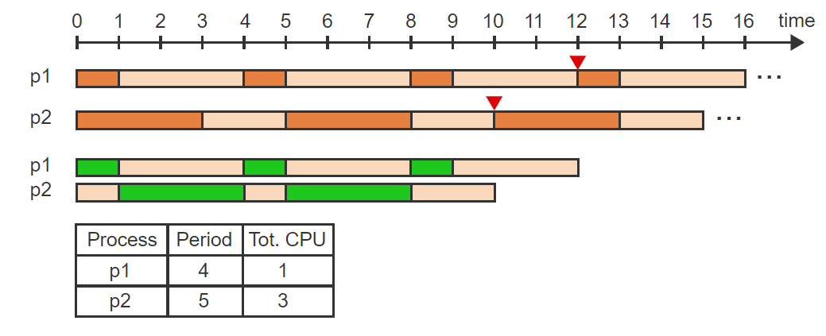
EDF Visualized – 5
The next iteration of p2 is available at time 5 with a deadline of 10. Only p2 is available and so p2 runs from 5 to 8. p2 is followed again by p1 at time 8 with a new deadline of 12

Slide 37
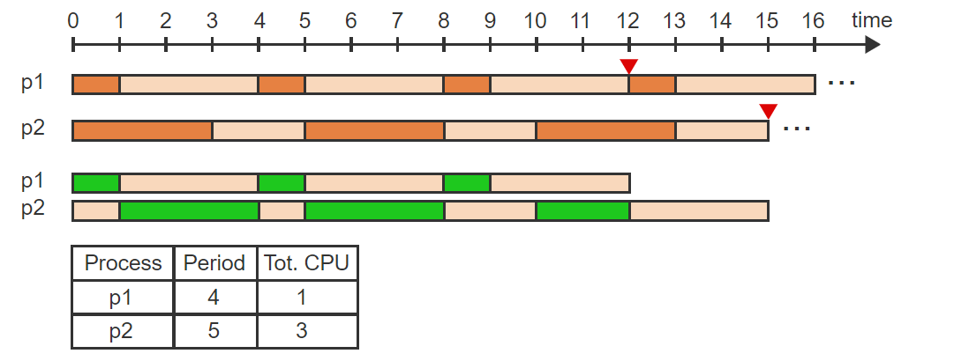
EDF Visualized – 6
p2's deadline moves to 15 and since p1 is not available yet, p2 start executing

Slide 38
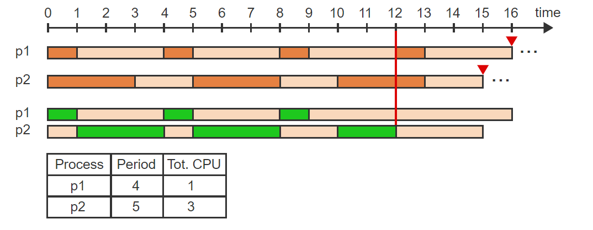
EDF Visualized – 7
At time 12, p1 is again available with a deadline 16 and p2 still needs 1 more unit to complete with a deadline of 15

Slide 39
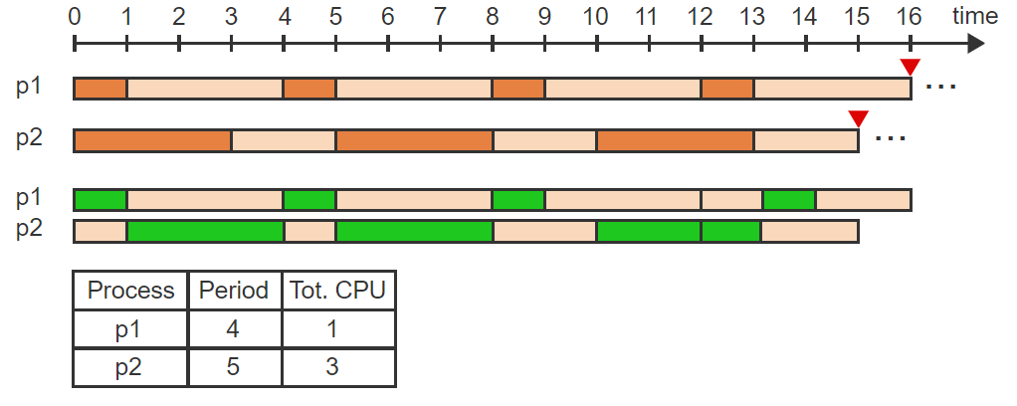
EDF Visualized – 8
p2 has a higher priority and completes the computation at time 13. p1 follows from time 13 to 14

Slide 40
Important Terms
Feasibility: A schedule is feasible if the deadlines of all processes can be met.
The CPU utilization (U) is the sum of the individual fractions of CPU times used by each process.

Slide 41
EDF Versus RM
EDF has some perks:
If CPU utilization is under 100% we know that all deadlines will be met (optimal).
RM has some perks as well:
Under RM we can predict which tasks will miss their deadlines.
The problem with RM however, is that we can only achieve optimal status (i.e., all deadlines will be met) if the CPU utilization is 69.3% or less. [1]
Notes:
[1] Rapita Systems Ltd., shorturl.at/DIMS3, retrieved January 6th, 2021.

Slide 42
Combined Approaches to Scheduling
An OS running only batch processes or only real-time processes could rely on only one of the suitable algorithms. Ex: SJF for a batch OS and EDF for a real-time OS. A general-purpose OS needs to handle different types of processes and thus a combination of different scheduling algorithms must be used.
The simplest approach is to divide processes into two groups (2 tier approach). Real-time processes run at the highest priority level but due to their short running times can use FIFO. Interactive and batch processes can be scheduled together using MLF.

Slide 43
2-Tier Approach w/Floating Priorities
Most modern general-purpose OSs (Ex: Windows, Linux) use more sophisticated scheduling strategies to provide more flexibility.
Real time processes use either FIFO or RR in an ML scheme. Interactive and batch processes use a variation of MLF.
Every process is assigned a base priority at creation but an increment is added based on the past action the process has taken. E.g., Returning from a request for keyboard input would add 6 to the base priority while returning from a request for disk input would add only 1.
Therefore, the current priority depends on the type of process and the process's behavior.

Slide 44

Onto Concurrency

Slide 45
Process Interactions – Concurrency
Concurrency is the act of multiple processes (or threads) executing at the same time. When multiple physical CPUs are available, the processes may execute in parallel. On a single CPU, concurrency may be achieved by time-sharing.
When concurrent processes access a common data area, the data must be protected from simultaneous change by two or more processes. Otherwise the updated area may be left in an inconsistent state.
A critical section is a segment of code that cannot be entered by a process while another process is executing a corresponding segment of the code.

Slide 46
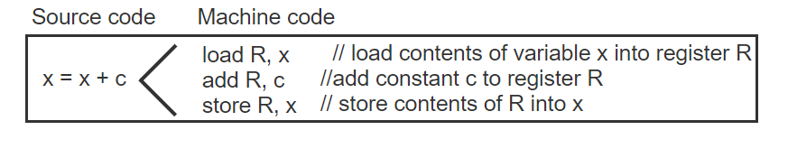
Critical Section – Visualized -1
A source code instruction x = x + c is compiled into 3 machine-level instructions using a CPU register R

Slide 47
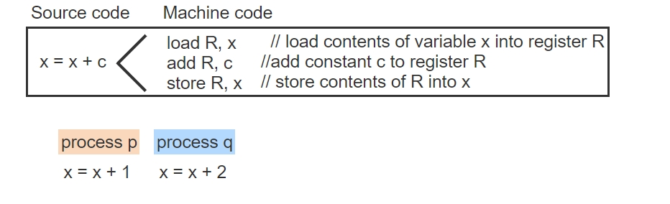
Critical Section – Visualized - 2
Process p executes the instruction x = x + 1. Process q executes the instruction x = x + 2

Slide 48
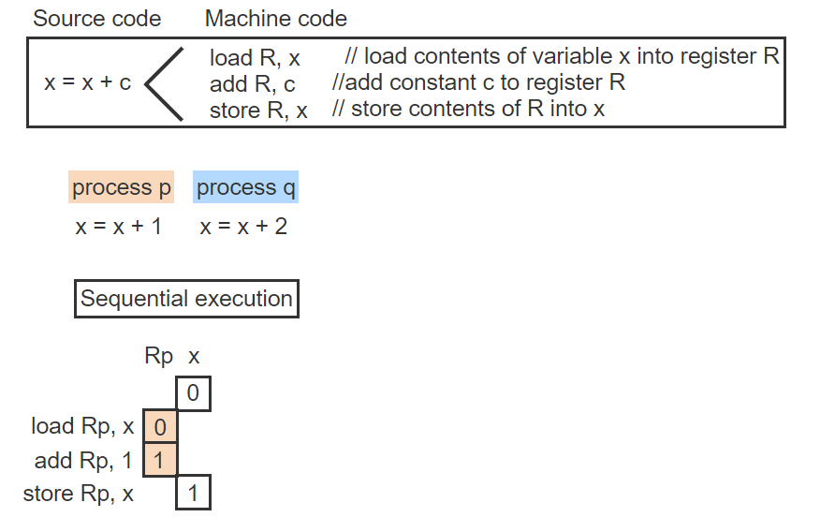
Critical Section – Visualized - 3
If the initial value of x is 0 and p executes the code first then p loads 0 into Rp, increments Rp by 1, and stores the result back into x

Slide 49
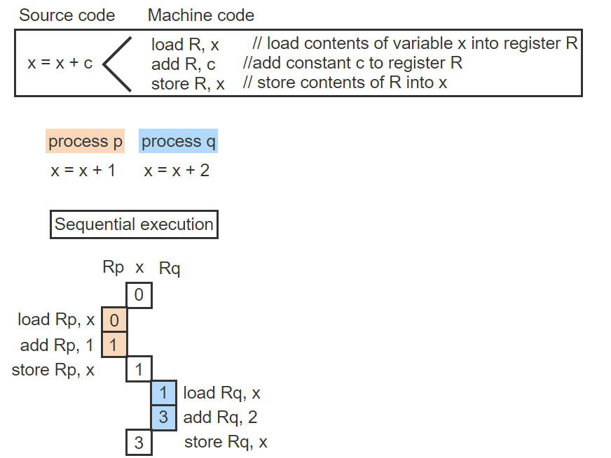
Critical Section – Visualized - 4
If q executes next then q loads the updated value of x into Rq, increments Rq by 2, and stores the value back into x. The final value of x is 3 as expected

Slide 50
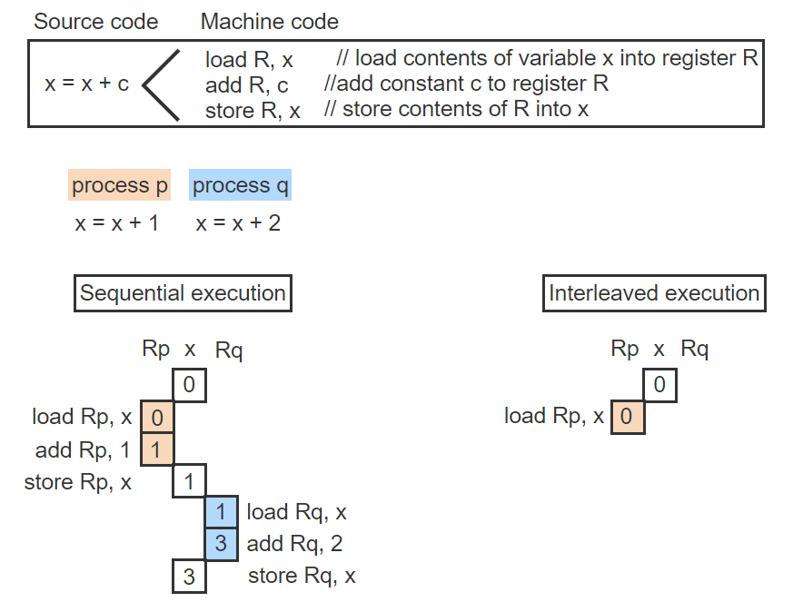
Critical Section – Visualized - 5
Context switching can interleave the execution of p and q. First p loads the initial value of x = 0 into Rp

Slide 51
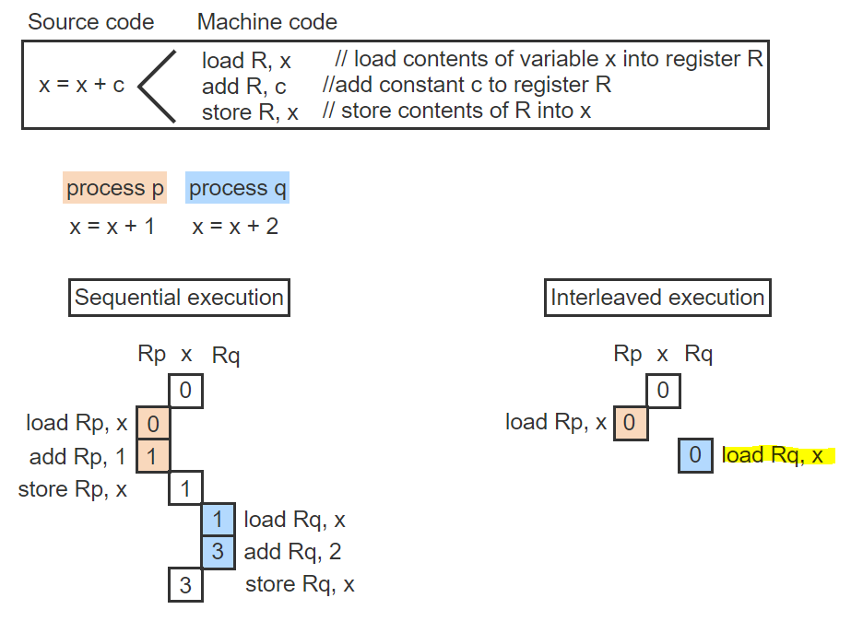
Critical Section – Visualized - 6
Next, q loads the same initial value x = 0 into Rq

Slide 52
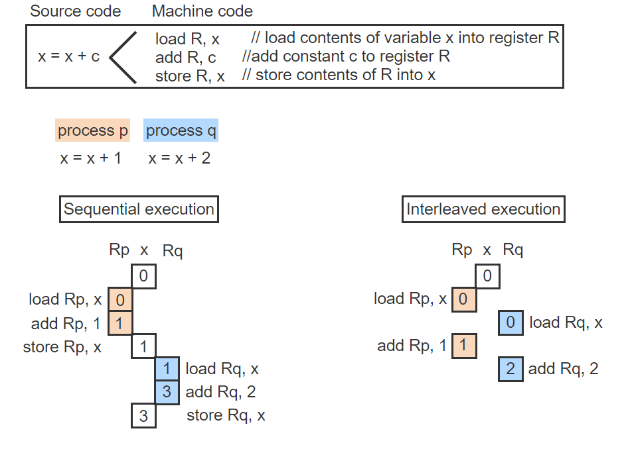
Critical Section – Visualized - 7
Next, p increments Rp by 1 and q increments Rq by 2

Slide 53
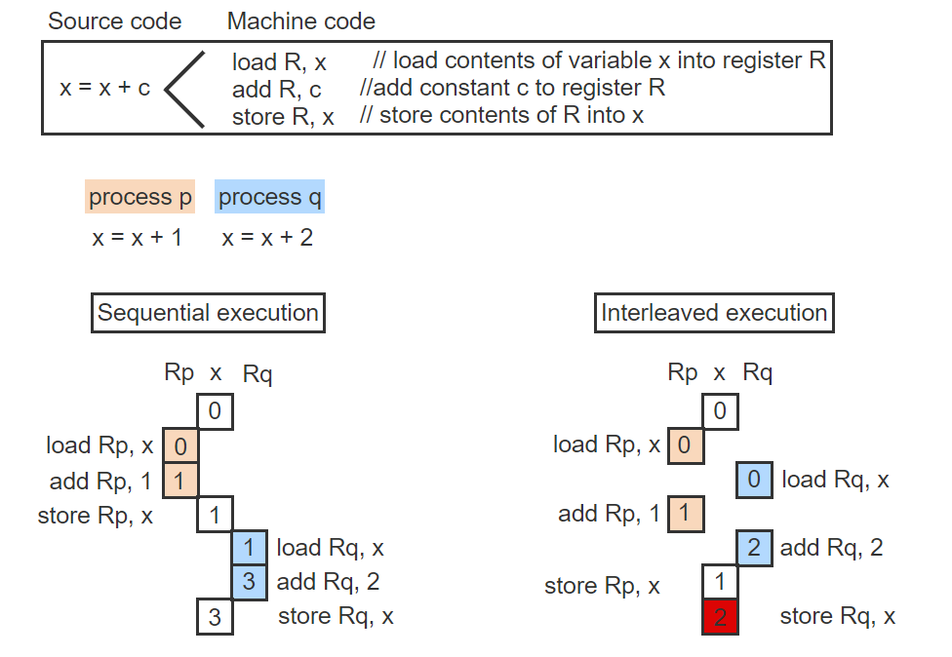
Critical Section – Visualized - 8
Finally, p stores the value of Rp = 1 into x but q overwrites the value with Rq, which is 2. The update of x by p has been lost, resulting in an incorrect result.
This is a critical section problem.

Slide 54
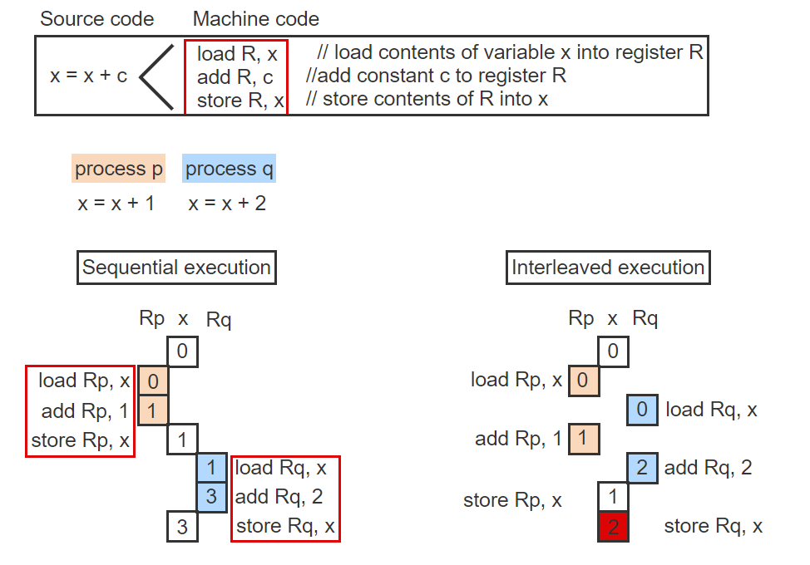
Critical Section – Visualized - 9
The sequence of the 3 instructions corresponding to the source code instruction x = x + c is a critical section and must not be interleaved

Slide 55

Exercise
Processes p and q execute the instructions x = x + 1 and x = x + 2, respectively. Initially x = 0. After execution of the interleaved code, x = _____
p: q:
load Rp,x
load Rq,x
add Rp,1
add Rq,2
store Rq,x
store Rp,x

Slide 56
Exercise – Solution
Processes p and q execute the instructions x = x + 1 and x = x + 2, respectively. Initially x = 0. After execution of the interleaved code, x = 1
Both p and q load the same initial value of x = 0 and independently increment the registers. q stores the value 2 into x but the effect is lost because p overwrites the value of x with 1.

Slide 57
Critical Section Problem Solutions
Many solutions to the critical section problem exist. However, any solution must meet the following requirements:
Guarantee mutual exclusion: Only one process may be executing within the CS.
Prevent lockout: A process not attempting to enter the CS must not prevent other processes from entering the CS.
Prevent starvation: A process (or a group of processes) must not be able to repeatedly enter the CS while other processes are waiting to enter.
Prevent deadlock: Multiple processes trying to enter the CS at the same time must not block each other indefinitely.

Slide 58
Critical Section Problem (CSP) – Solution
Let us visualize a solution to the critical section problem.
In the following solution, a process indicates the interest to enter the CS by setting the variable c1 or c2 to 1. A third variable, will_wait, is used to break the tie if both processes try to enter CS simultaneously.

Slide 59
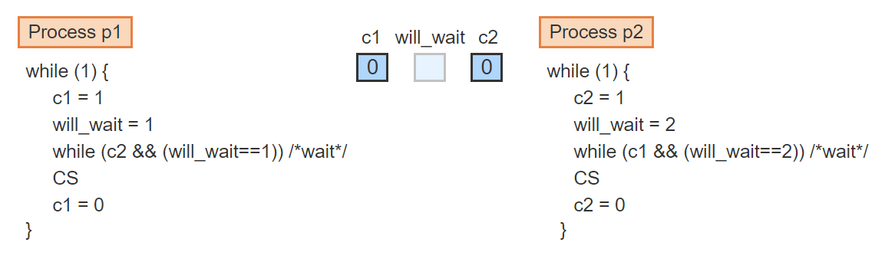
CSP – Solutions Visualized – 1
Processes p1 and p2 share a critical section CS. The initial values of c1 and c2 are 0. The initial value of will_wait is irrelevant

Slide 60
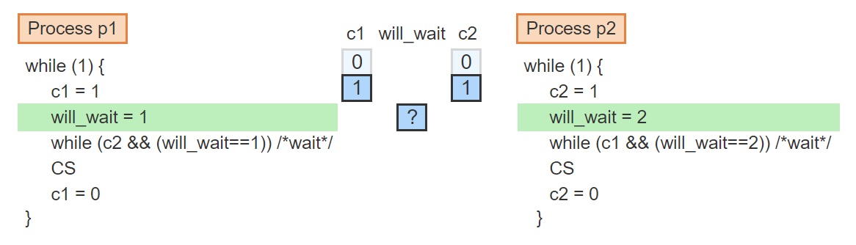
CSP – Solutions Visualized – 2
Mutual exclusion is guaranteed. When both processes execute concurrently, c1 and c2 are both set to 1. But will_wait can only have one value, 1 or 2. The memory hardware does the writes in sequence

Slide 61
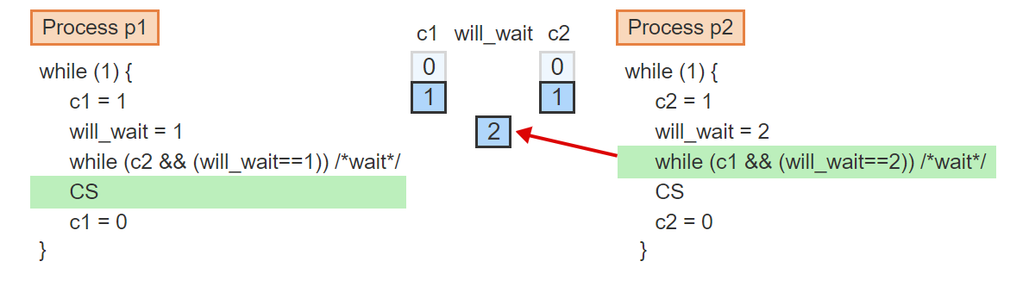
CSP – Solutions Visualized – 3
If p1 writes first, p2's subsequent write makes will_wait = 2. p1 wins the race and enters CS while p2 waits

Slide 62
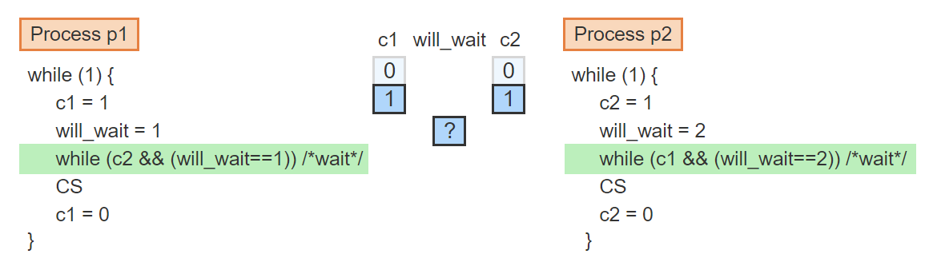
CSP – Solutions Visualized – 4
Deadlock is prevented for the same reason that guarantees mutual exclusion. When both processes enter the wait loop, one will always pass through because will_wait can only be 1 or 2

Slide 63
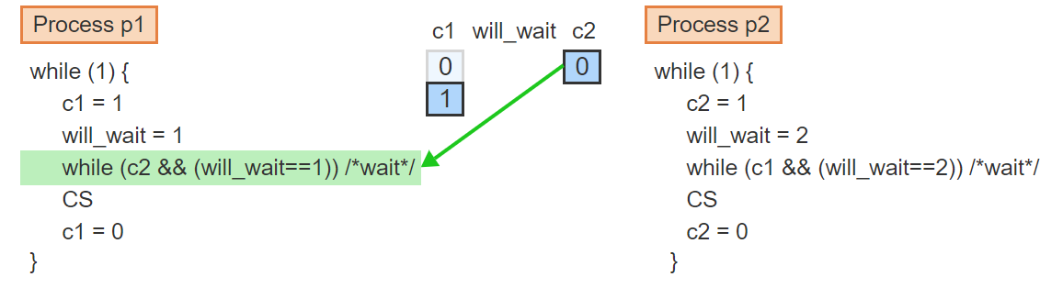
CSP – Solutions Visualized – 5
Lockout is also not possible. When p2 is not trying to enter CS, c2 = 0. Consequently, p1 may enter CS repeatedly, regardless of the value of will_wait.

Slide 64
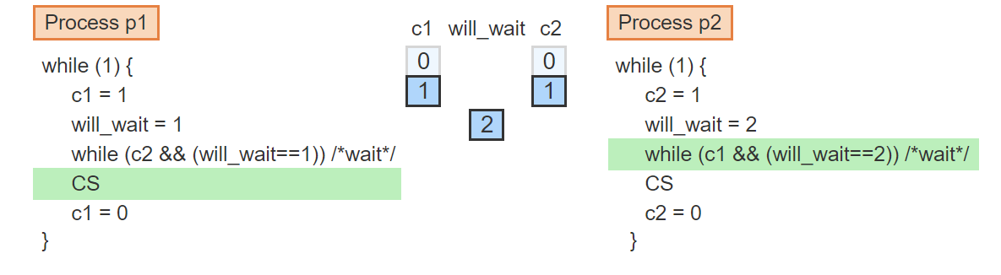
CSP – Solutions Visualized – 6
Finally, starvation is also not possible. When p1 is in CS and p2 is in the wait loop, both c1 = c2 = 1 and will_wait = 2

Slide 65
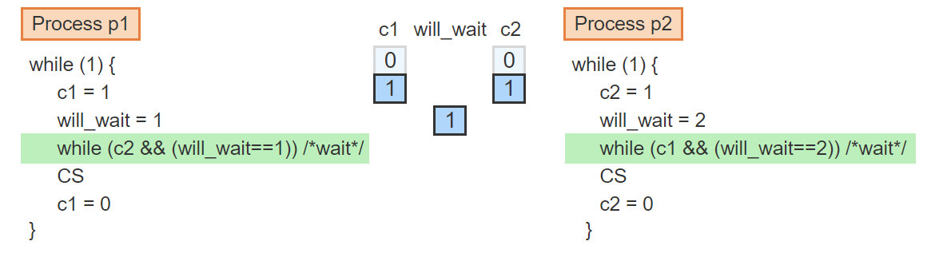
CSP – Solutions Visualized – 7
If p1 wants to execute CS again, p1 must first set will_wait = 1

Slide 66
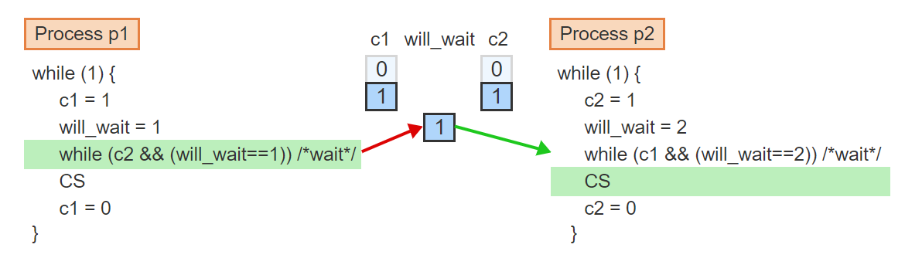
CSP – Solutions Visualized – 8
Since will_wait = 1, p1 must wait while p2 enters CS. Thus p1 cannot starve p2 by entering CS repeatedly

Slide 67
Process Cooperation
In addition to the CS problem, where processes compete for access to a shared resource, many applications require the cooperation of processes to solve a common goal.
A typical scenario is when one process produces data needed by another process.
The producer process must be able to inform the waiting process whenever a new data item is available.
In turn, the producer must wait for an acknowledgement from the consumer, indicating that the consumer is ready to accept the next data item.

Slide 68
CSP - Solution
The CSP solution we discussed has major drawbacks.
The solutions works only for 2 processes. When 3 or more processes need to share a CS, a different solution must be developed.
The solution is inefficient. While one process is in the CS, the other process must wait by repeatedly testing and setting the synchronization variables. The waiting process is only wasting CPU and memory resources without accomplishing any useful work.
The solution addresses only competition among processes. To address problems of process cooperation, entirely different solutions must be devised.
Enter Sempahores!

Slide 69
Semaphores
Semaphores are general-purpose primitives that allow solving a variety of synchronization problems in a systematic manner.
A semaphore s is a non-negative integer variable that can be accessed using only two special operations, P and V.
V(s): increment s by 1
P(s): if s > 0, decrement s by 1, otherwise wait until s > 0
The implementation of P and V must guarantee that:
If several processes simultaneously invoke P(s) or V(s), the operations will occur sequentially in some arbitrary order.
If more than one process is waiting inside P(s) for s to become > 0 , one of the waiting processes is selected arbitrarily to complete the P(s) operation.

Slide 70
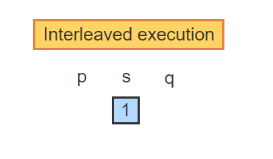
Operations on Semaphore – Visualized – 1
Two concurrent processes p and q share a semaphore s. The initial value is s = 1

Slide 71
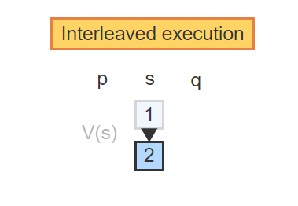
Operations on Semaphore – Visualized – 2
p executes V(s), which increments s by 1

Slide 72
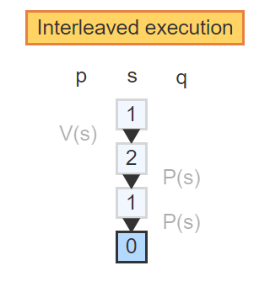
Operations on Semaphore – Visualized – 3
q executes P(s) twice. Since s = 2, each P(s) operation successfully decrements s and q continues executing

Slide 73
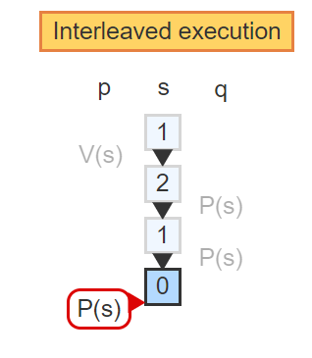
Operations on Semaphore – Visualized – 4
When p executes P(s), s = 0 and so p becomes blocked on s

Slide 74
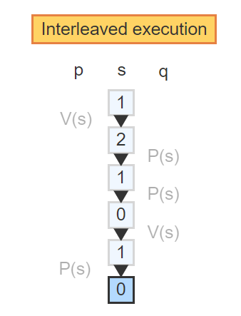
Operations on Semaphore – Visualized – 5
When q executes V(s), s becomes 1, which unblocks p. The P(s) operation by p can now decrement s and p may continue executing

Slide 75
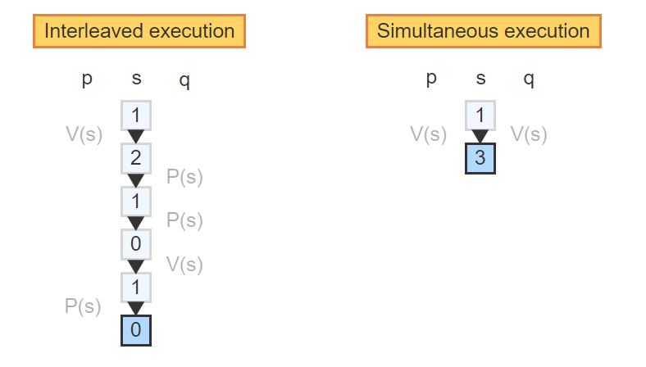
Operations on Semaphore – Visualized – 6
When p and q execute V(s) simultaneously, the implementation executes the operations in a random order. The value of s is incremented by 2

Slide 76
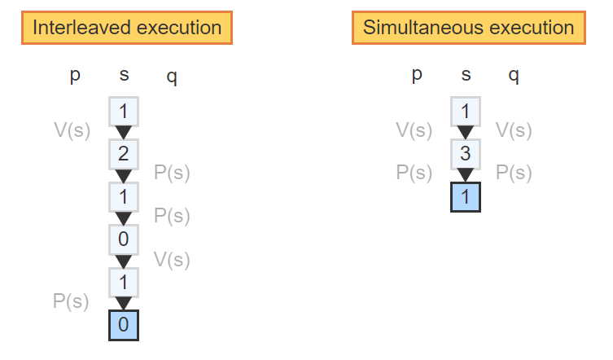
Operations on Semaphore – Visualized – 7
Similarly, when p and q execute P(s) simultaneously, the implementation executes the operations in a random order. The value of s is decremented by 2 and p and q continue

Slide 77

Operations on Semaphore – Visualized – 8
When s = 1 and both processes execute P(s) then one process is chosen at random to process while the other process is blocked on the semaphore

Slide 78

Operations on Semaphore – Visualized – 9
When a V(s) operation increments s again, p becomes unblocked

Slide 79

Operations on Semaphore – Visualized – 10
The P(s) operation can now complete by decrementing s and p may continue

Slide 80
Exercise
Say a semaphore s = 0 initially.
Process p1 executes the sequence: P(s); P(s); V(s);
Process p2 executes the sequence: V(s); V(s);
Keep in mind:
V(s): increment s by 1
P(s): if s > 0, decrement s by 1, otherwise wait until s > 0
After both processes terminate s should equal what?
Which statement will terminate first?

Slide 81
Exercise – Solution
After both processes terminate, s = 1
p2 increments s twice. p1 decrements s twice and then increments s by 1.
Which statement will terminate first?
p2’s first V(S) will terminate first.
s = 0 initially, so p1's first P(s) will block until p2 increments s.

Slide 82
CSP Using Semaphores
Semaphores offer a very intuitive and elegant solution to the CS problem that satisfies all requirements. A single semaphore, initialized to 1, is sufficient to solve the problem for any number of processes.
We will delve deeper into different types of semaphores and take a look at a C implementation next class.

Slide 83
Onto C Programming!

Slide 84
Functions in C
A few things to note about functions in C:
All parameters are passed by value!
Variables declared within a function are method local variables (e.g., cannot be seen outside the function).
Placement of functions
Large programs:
Manage related function in a .c file.
Write a .h file containing all the prototypes of the functions.
#include the header file in the files that uses the functions.
Small Programs:
Place your functions in the same .c file, preferably in the following order:
All prototypes
main() function
Other functions

Slide 85
Function Prototype in C
A function prototype is simply the declaration of a function that specifies function's name, parameters and return type. It doesn't contain function body.
If you define the function body at the beginning of your program you don’t need to use a prototype.

Slide 86
//One way to do things.
#include <stdio.h>
int addNumbers(int a, int b); // function prototype
int main()
{
int n1,n2,sum;
printf("Enters two numbers: ");
scanf("%d %d",&n1,&n2);
sum = addNumbers(n1, n2); // function call
printf("sum = %d",sum);
return 0;
}
int addNumbers(int a, int b) // function definition
{
int result;
result = a+b;
return result; // return statement
}

Slide 87
//Another way to do things.
#include <stdio.h>
//addNumbers is declared and defined at the top, hence no need for a prototype.
int addNumbers(int a, int b) // function definition
{
int result;
result = a+b;
return result; // return statement
}
int main()
{
int n1,n2,sum;
printf("Enters two numbers: ");
scanf("%d %d",&n1,&n2);
sum = addNumbers(n1, n2); // function call
printf("sum = %d",sum);
return 0;
}

Slide 88
Strings in C
Strings in C are simply arrays of characters.
For example:
char s[10];
This is a ten (10) element array that can hold a character string consisting of ≤ 9 characters.
This is because C does not know where the end of an array is at run time.
By convention, C uses a NULL character '\0' to terminate all strings in its library functions
For example:
char str [10] = {'u', 'n', 'I', 'x', '\0’};
It’s the string terminator (not the size of the array) that determines the length of the string.

Slide 89

Accessing Individual Characters
The first element of any array in C is at index 0. The second is at index 1, and so on ...
char s[10];
s[0] = 'h';
s[1] = 'i’;
s[2] = '!';
s[3] = '\0’;
This notation can be used in all kinds of statements and expressions in C:
c = s[1];
if (s[0] == '-') …
switch (s[1]) ...

Slide 90
String Literals
String literals are given as a string quoted by double quotes.
printf("Long long ago.");
Initializing char array ...
char s[10]="unix"; /* s[4] is '\0'; */
char s[ ]="unix"; /* s has five elements */

Slide 91
Printing Strings with Printf()
Example:
char str[ ] = "A message to display";
printf ("%s\n", str);
printf expects to receive a string as an additional parameter when it sees %s in the format string.
Can be from a character array.
Can be another literal string.
Can be from a character pointer (more on this later).
printf knows how much to print out because of the NULL character at the end of all strings

Slide 92
Example
char str[10]="unix and c";
printf("%s", str);
printf("\n");
str[6]='\0';
printf("%s", str);
printf("\n");
printf("\n");
printf(str);
printf("\n");
str[2]='%';
printf(str);
printf("\n");

Slide 93
More Work
Research:
Printing with the puts() function.
String input with the gets() function.
Lastly, inputting strings with the scanf function
Play around with it and have fun.
Did you take the string datatype for granted before?

